Slide 1
Chapter 5 C Functions
C How to Program, 8/e
©2016 Pearson Education, Inc., Hoboken, NJ. All rights reserved.
1

Slide 2
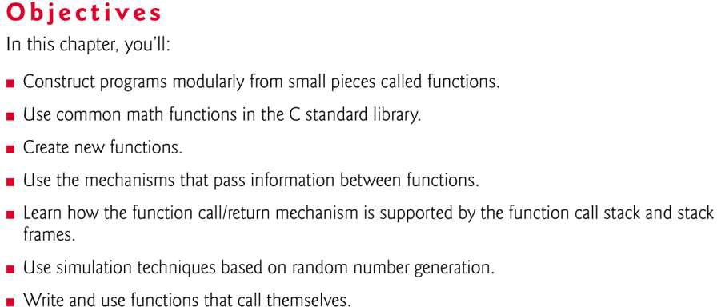
©2016 Pearson Education, Inc., Hoboken, NJ. All rights reserved.
1

Slide 3
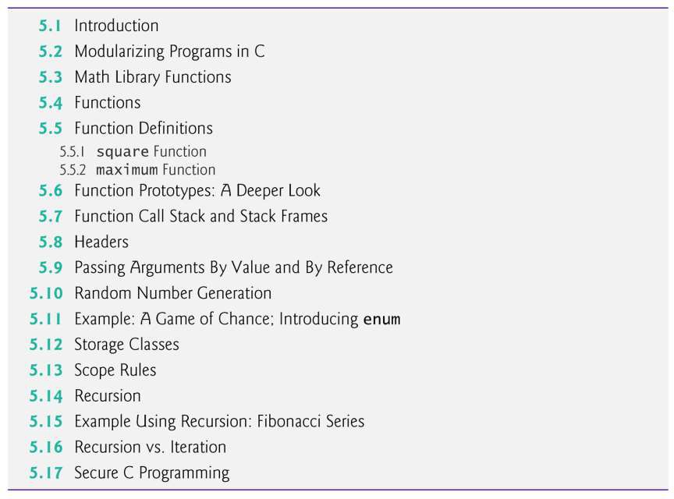
©2016 Pearson Education, Inc., Hoboken, NJ. All rights reserved.
1

Slide 4
5.1 Introduction
Most computer programs that solve real-world
problems are much larger than the programs presented in the first few chapters.
Experience has shown that the best way to
develop and maintain a large program is to
construct it from smaller pieces, each of which is more manageable than the original program.
This technique is called divide and conquer.
This chapter describes some key features of the
C language that facilitate the design,
implementation, operation and maintenance of large programs.
4

Slide 5
5.2 Modularizing Programs in C
Functions are used to modularize programs
C programs are typically written by combining new functions you write with prepackaged functions available in the C standard library.
The C standard library provides a rich collection of functions for performing common mathematical calculations, string manipulations, character manipulations, input/output, and many other useful operations.
4

Slide 6
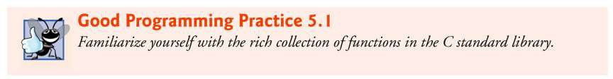
©2016 Pearson Education, Inc., Hoboken, NJ. All rights reserved.
6

Slide 7
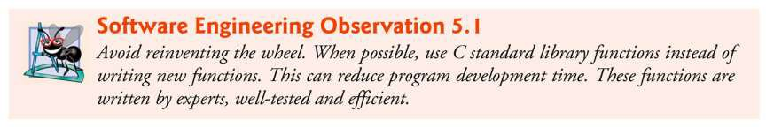
©2016 Pearson Education, Inc., Hoboken, NJ. All rights reserved.
6

Slide 8
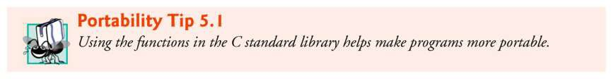
©2016 Pearson Education, Inc., Hoboken, NJ. All rights reserved.
6

Slide 9
5.2 Modularizing Programs in C (Cont.)
The functions printf, scanf and pow that we’ve used in
previous chapters are standard library functions.
You can write your own functions to define tasks that may be
used at many points in a program.
These are sometimes referred to as programmer-defined functions.
The statements defining the function are written only once, and the statements are hidden from other functions.
Functions are invoked by a function call, which specifies the function name and provides information (as arguments) that the called function needs to perform its designated task.
10

Slide 10
5.2 Modularizing Programs in C (Cont.)
A common analogy for this is the hierarchical form of management.
A boss (the calling function or caller) asks a worker (the called function) to perform a task and report back when the task is done (Fig. 5.1).
For example, a function needing to display information on the screen calls the worker function printf to perform that task, then printf displays the information and reports back—or returns—to the calling function when its task is completed.
The boss function does not know how the worker function performs its designated tasks.
10

Slide 11
5.2 Modularizing Programs in C (Cont.)
The worker may call other worker functions, and the boss will be unaware of this.
We’ll soon see how this “hiding” of implementation details promotes good software engineering.
Figure 5.1 shows a boss function communicating with several worker functions in a hierarchical manner.
Note that worker1 acts as a boss function to
worker4 and worker5.
Relationships among functions may differ from the hierarchical structure shown in this figure.
10

Slide 12
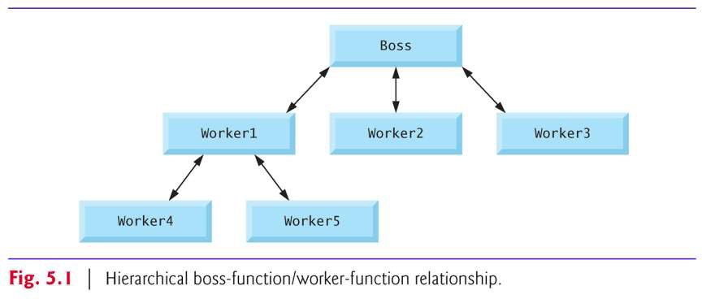
©2016 Pearson Education, Inc., Hoboken, NJ. All rights reserved.
12

Slide 13
5.3 Math Library Functions
Math library functions allow you to perform certain common mathematical calculations.
Functions are normally used in a program by writing the name of the function followed by a left parenthesis followed by the argument (or a comma-separated list of arguments) of the function followed by a right parenthesis.
For example, a programmer desiring to calculate and print the square root of 900.0 you might write
printf("%.2f", sqrt(900.0));
When this statement executes, the math library function sqrt is called to calculate the square root of the number contained in the parentheses (900.0).
13

Slide 14
5.3 Math Library Functions (Cont.)
The number 900.0 is the argument of the sqrt
function.
The preceding statement would print 30.00.
The sqrt function takes an argument of type
double and returns a result of type double.
All functions in the math library that return floating-point values return the data type double.
Note that double values, like float values, can be output using the %f conversion specification.
13

Slide 15
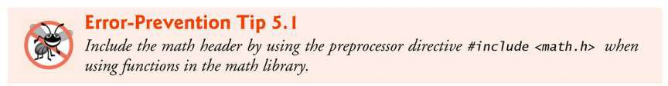
©2016 Pearson Education, Inc., Hoboken, NJ. All rights reserved.
15

Slide 16
5.3 Math Library Functions (Cont.)
Function arguments may be constants, variables, or expressions.
If c1 = 13.0, d = 3.0 and f = 4.0, then the statement
printf("%.2f", sqrt(c1 + d * f));
calculates and prints the square root of
13.0 + 3.0 * 4.0 = 25.0, namely 5.00.
In the figure, the variables x and y are of type double.
©2016 Pearson Education, Inc., Hoboken, NJ. All rights reserved.
16

Slide 17
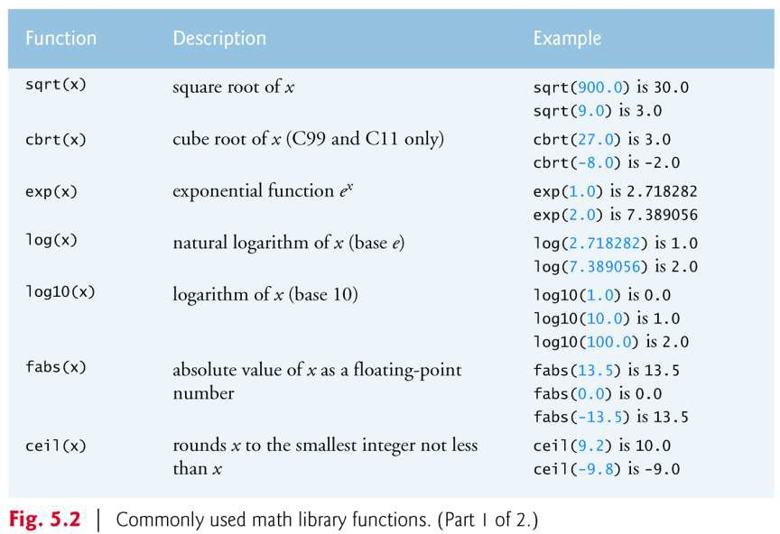
©2016 Pearson Education, Inc., Hoboken, NJ. All rights reserved.
17

Slide 18
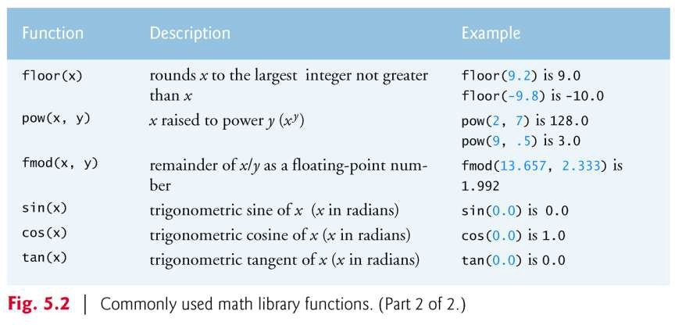
©2016 Pearson Education, Inc., Hoboken, NJ. All rights reserved.
17

Slide 19
5.4 Functions
Functions allow you to modularize a program.
All variables defined in function definitions are local variables—they can be accessed only in the function in which they’re defined.
Most functions have a list of parameters that provide the means for communicating information between functions.
A function’s parameters are also local variables of that function.
©2016 Pearson Education, Inc., Hoboken, NJ. All rights reserved.
19

Slide 20
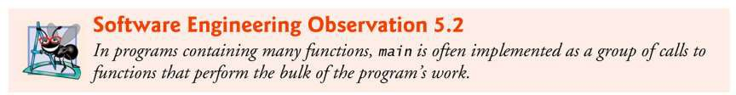
©2016 Pearson Education, Inc., Hoboken, NJ. All rights reserved.
20

Slide 21
5.4 Functions (Cont.)
There are several motivations for “functionalizing” a program.
The divide-and-conquer approach makes program development more manageable.
Another motivation is software reusability—using existing functions as building blocks to create new programs.
Software reusability is a major factor in the object-oriented programming movement that you’ll learn more about when you study languages derived from C, such as C++, Java and C#
(pronounced “C sharp”).
We use abstraction each time we use standard library functions like
printf, scanf and pow.
A third motivation is to avoid repeating code in a program.
Packaging code as a function allows the code to be executed from other locations in a program simply by calling the function.
©2016 Pearson Education, Inc., Hoboken, NJ. All rights reserved.
21

Slide 22
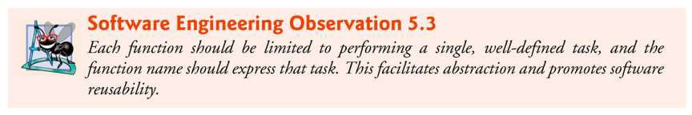
©2016 Pearson Education, Inc., Hoboken, NJ. All rights reserved.
22

Slide 23
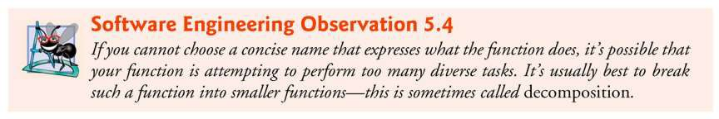
©2016 Pearson Education, Inc., Hoboken, NJ. All rights reserved.
22

Slide 24
5.5 Function Definitions
Each program we’ve presented has consisted of a function called main that called standard library functions to accomplish its tasks.
We now consider how to write custom functions.
Consider a program that uses a function square to calculate and print the squares of the integers from 1 to 10 (Fig. 5.3).
©2016 Pearson Education, Inc., Hoboken, NJ. All rights reserved.
24

Slide 25
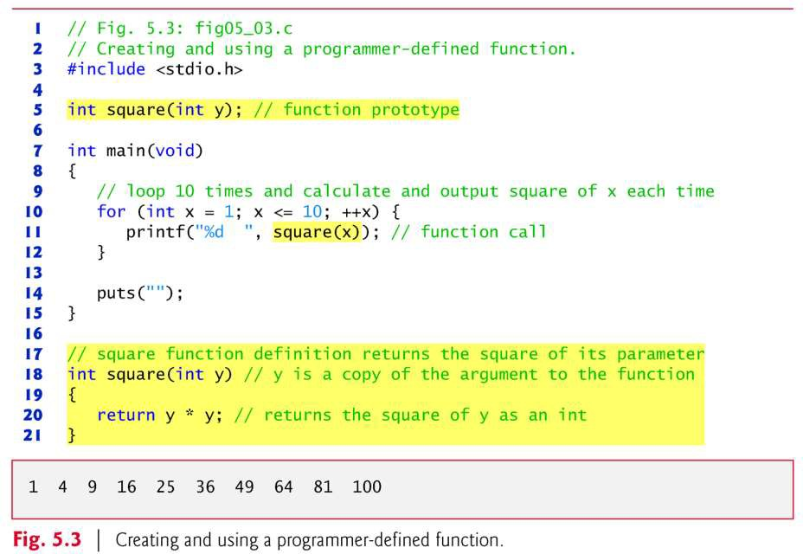
©2016 Pearson Education, Inc., Hoboken, NJ. All rights reserved.
25

Slide 26
5.5 Function Definitions (Cont.)
Function square is invoked or called in main within the
printf statement
printf("%d ", square(x)); // function call
Function square receives a copy of the value of x in the parameter y.
Then square calculates y * y.
The result is passed back returned to function printf in main where square was invoked, and printf displays the result.
This process is repeated 10 times using the for
statement.
26

Slide 27
5.5 Function Definitions (Cont.)
The definition of function square shows that square
expects an integer parameter y.
The keyword int preceding the function name indicates that square returns an integer result.
The return statement in square passes the value of the expression y * y (that is, the result of the calculation) back to the calling function.
int square(int y); // function prototype
– The int in parentheses informs the compiler that square
expects to receive an integer value from the caller.
26

Slide 28
5.5 Function Definitions (Cont.)
The int to the left of the function name square informs the compiler that square returns an integer result to the caller.
The compiler refers to the function prototype to check that any calls to square contain the correct return type, the correct number of arguments, the correct argument types, and that the arguments are in the correct order.
The format of a function definition is
return-value-type function-name(parameter-list)
{
definitions statements
}
26

Slide 29
5.5 Function Definitions (Cont.)
The function-name is any valid identifier.
The return-value-type is the data type of the result returned to the caller.
The return-value-type void indicates that a function does not return a value.
Together, the return-value-type, function- name and parameter-list are sometimes referred to as the function header.
26

Slide 30
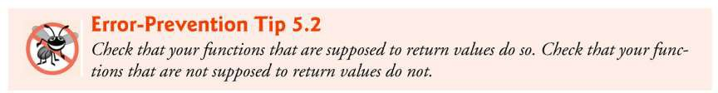
©2016 Pearson Education, Inc., Hoboken, NJ. All rights reserved.
30

Slide 31
5.5 Function Definitions (Cont.)
The parameter-list is a comma-separated list that specifies the parameters received by the function when it’s called.
If a function does not receive any values,
parameter-list is void.
A type must be listed explicitly for each parameter.
©2016 Pearson Education, Inc., Hoboken, NJ. All rights reserved.
31

Slide 32
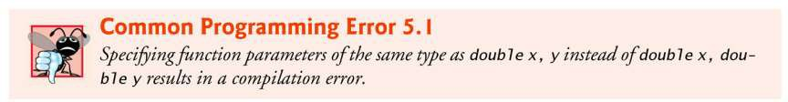
©2016 Pearson Education, Inc., Hoboken, NJ. All rights reserved.
32

Slide 33
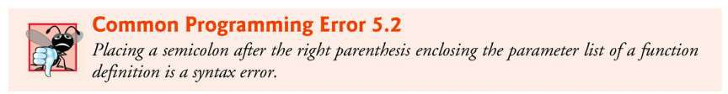
©2016 Pearson Education, Inc., Hoboken, NJ. All rights reserved.
32

Slide 34
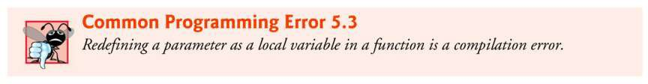
©2016 Pearson Education, Inc., Hoboken, NJ. All rights reserved.
32

Slide 35
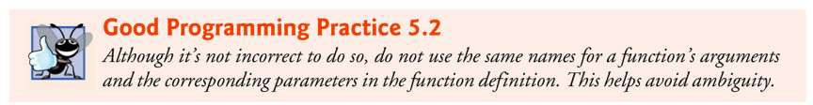
©2016 Pearson Education, Inc., Hoboken, NJ. All rights reserved.
32

Slide 36
5.5 Function Definitions (Cont.)
The definitions and statements within braces form the function body, which is also referred to as a block.
Variables can be declared in any block, and blocks can be nested.
©2016 Pearson Education, Inc., Hoboken, NJ. All rights reserved.
36

Slide 37
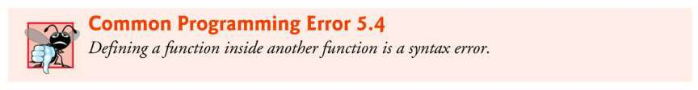
©2016 Pearson Education, Inc., Hoboken, NJ. All rights reserved.
37

Slide 38
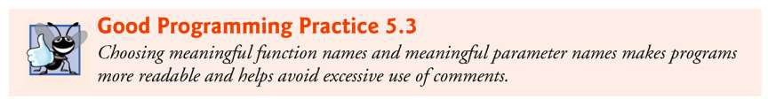
©2016 Pearson Education, Inc., Hoboken, NJ. All rights reserved.
37

Slide 39
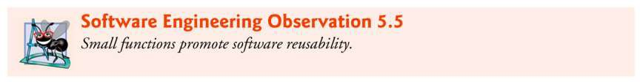
©2016 Pearson Education, Inc., Hoboken, NJ. All rights reserved.
37

Slide 40
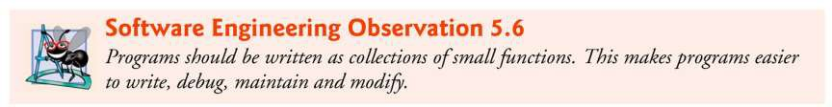
©2016 Pearson Education, Inc., Hoboken, NJ. All rights reserved.
37

Slide 41
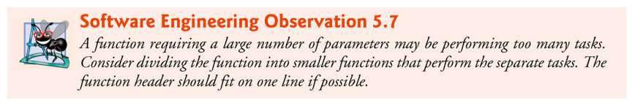
©2016 Pearson Education, Inc., Hoboken, NJ. All rights reserved.
37

Slide 42
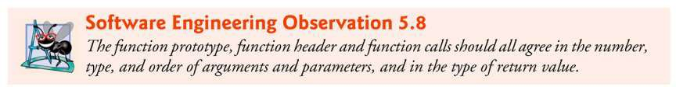
©2016 Pearson Education, Inc., Hoboken, NJ. All rights reserved.
37

Slide 43
5.5 Function Definitions (Cont.)
There are three ways to return control from a called function to the point at which a function was invoked.
If the function does not return a result, control is returned simply when the function-ending right brace is reached, or by executing the statement
return;
If the function does return a result, the statement
return expression;
returns the value of expression to the caller.
43

Slide 44
5.5 Function Definitions (Cont.)
main’s Return Type
Notice that main has an int return type.
The return value of main is used to indicate whether the program executed correctly.
In earlier versions of C, we’d explicitly place
return 0;
at the end of main—0 indicates that a program ran
successfully.
The C standard indicates that main implicitly returns 0 if you to omit the preceding statement—as we’ve done throughout this book.
43

Slide 45
5.5 Function Definitions (Cont.)
You can explicitly return non-zero values from main to
indicate that a problem occurred during your program’s execution.
For information on how to report a program failure, see the documentation for your particular operating-system environment.
43

Slide 46
5.5 Function Definitions (Cont.)
Function maximum
Our second example uses a programmer- defined function maximum to determine and return the largest of three integers
(Fig. 5.4).
Next, they’re passed to maximum, which determines the largest integer.
This value is returned to main by the
return statement in maximum.
43

Slide 47
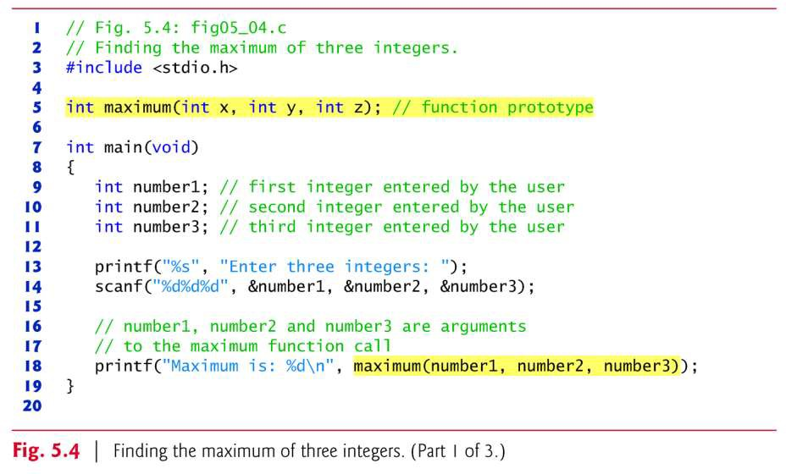
©2016 Pearson Education, Inc., Hoboken, NJ. All rights reserved.
47

Slide 48
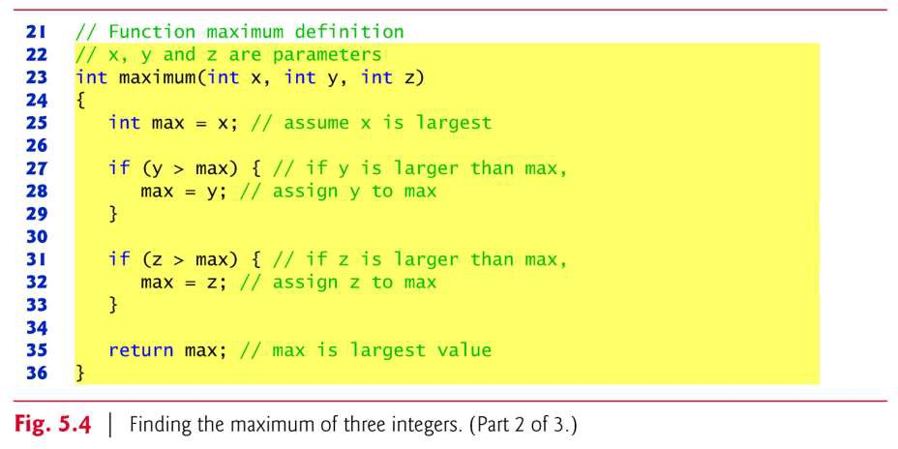
©2016 Pearson Education, Inc., Hoboken, NJ. All rights reserved.
47

Slide 49
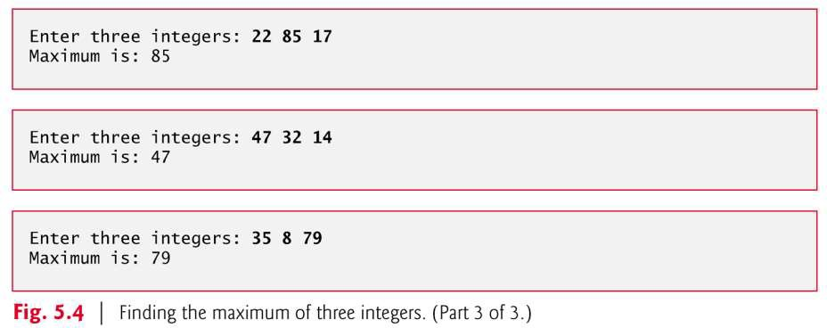
©2016 Pearson Education, Inc., Hoboken, NJ. All rights reserved.
47

Slide 50
5.6 Function Prototypes: A Deeper Look
An important feature of C is the function prototype.
This feature was borrowed from C++.
The compiler uses function prototypes to validate function calls.
50

Slide 51
5.6 Function Prototypes: A Deeper Look (Cont.)
Early versions of C did not perform this kind of checking, so it was possible to call functions improperly without the compiler detecting the errors.
Such calls could result in fatal execution- time errors or nonfatal errors that caused subtle, difficult-to-detect problems.
50

Slide 52
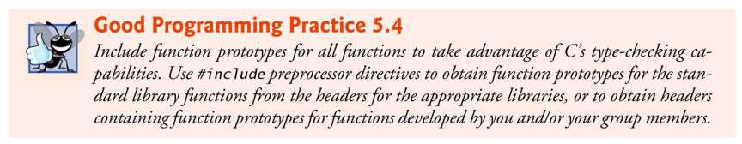
©2016 Pearson Education, Inc., Hoboken, NJ. All rights reserved.
52

Slide 53
5.6 Function Prototypes: A Deeper Look (Cont.)
The function prototype for maximum in Fig. 5.4 is
// function prototype
int maximum(int x, int y, int z);
It states that maximum takes three arguments of type int and returns a result of type int.
Notice that the function prototype is the same as the first line of maximum’s function definition.
©2016 Pearson Education, Inc., Hoboken, NJ. All rights reserved.
53

Slide 54
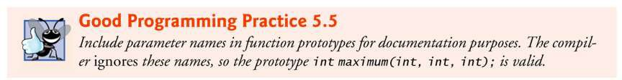
©2016 Pearson Education, Inc., Hoboken, NJ. All rights reserved.
54

Slide 55
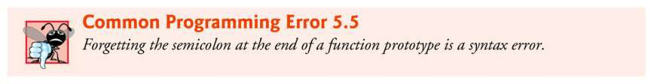
©2016 Pearson Education, Inc., Hoboken, NJ. All rights reserved.
54

Slide 56
5.6 Function Prototypes: A Deeper Look (Cont.)
Compilation Errors
A function call that does not match the function prototype is a compilation error.
An error is also generated if the function prototype and the function definition disagree.
For example, in Fig. 5.4, if the function prototype had been written
void maximum(int x, int y, int z);
the compiler would generate an error because the void return type in the function prototype would differ from the int return type in the function header.
56

Slide 57
5.6 Function Prototypes: A Deeper Look (Cont.)
Argument Coercion and “Usual Arithmetic Conversion Rules”
Another important feature of function prototypes is
the coercion of arguments, i.e., the forcing of arguments to the appropriate type.
For example, the math library function sqrt can be
called with an integer argument even though the
function prototype in <math.h> specifies a double
parameter, and the function will still work correctly.
The statement
printf("%.3f\n", sqrt(4));
correctly evaluates sqrt(4) and prints the value
2.000.
56

Slide 58
5.6 Function Prototypes: A Deeper Look (Cont.)
The function prototype causes the compiler to convert a copy of the integer value 4 to the double value 4.0 before the copy is passed to sqrt.
In general, argument values that do not correspond precisely to the parameter types in the function prototype are converted to the proper type before the function is called.
These conversions can lead to incorrect results if C’s usual arithmetic conversion rules are not followed.
These rules specify how values can be converted to other types without losing data.
56

Slide 59
5.6 Function Prototypes: A Deeper Look (Cont.)
In our sqrt example above, an int is automatically converted to a double without changing its value.
However, a double converted to an int truncates the fractional part of the double value, thus changing the original value.
Converting large integer types to small integer types (e.g., long to short) may also result in changed values.
56

Slide 60
5.6 Function Prototypes: A Deeper Look (Cont.)
The usual arithmetic conversion rules automatically apply to expressions containing values of two or more data types (also referred to as mixed-type expressions) and are handled for you by the compiler.
In a mixed-type expression, the compiler makes a temporary copy of the value that needs to be converted then converts the copy to the “highest” type in the expression—the original value remains unchanged.
56

Slide 61
5.6 Function Prototypes: A Deeper Look (Cont.)
The usual arithmetic conversion rules for a mixed-type expression containing at least one floating-point value are:
If one of the values is a long double, the other is converted to a long double.
If one of the values is a double, the other is converted to a double.
If one of the values is a float, the other is converted to a float.
56

Slide 62
5.6 Function Prototypes: A Deeper Look (Cont.)
If the mixed-type expression contains only integer types, then the usual arithmetic conversions specify a set of integer promotion rules.
In most cases, the integer types lower in Fig. 5.5 are converted to types higher in the figure.
Section 6.3.1 of the C standard document specifies the complete details of arithmetic operands and the usual arithmetic conversion rules.
Figure 5.5 lists the floating-point and data types with
each type’s printf and scanf conversion specifications.
56

Slide 63
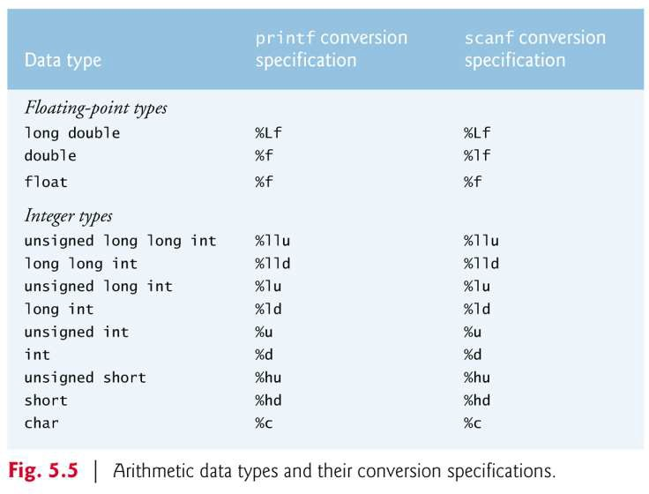
©2016 Pearson Education, Inc., Hoboken, NJ. All rights reserved.
63

Slide 64
5.6 Function Prototypes: A Deeper Look (Cont.)
A value can be converted to a lower type only by explicitly assigning the value to a variable of lower type, or by using a cast operator.
Function argument values are converted to the parameter types in a function prototype as if they were being assigned directly to variables of those types.
If our square function that uses an integer parameter (Fig. 5.3) is called with a floating-point argument, the argument is converted to int (a lower type), and square usually returns an incorrect value.
For example, square(4.5) returns 16, not 20.25.
©2016 Pearson Education, Inc., Hoboken, NJ. All rights reserved.
64

Slide 65
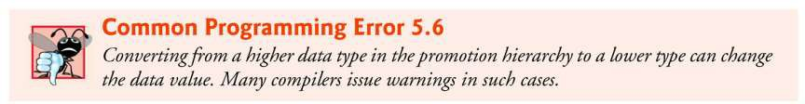
©2016 Pearson Education, Inc., Hoboken, NJ. All rights reserved.
65

Slide 66
5.6 Function Prototypes: A Deeper Look (Cont.)
If there is no function prototype for a function, the compiler forms its own function prototype using the first occurrence of the function—either the function definition or a call to the function.
This typically leads to warnings or errors, depending on the compiler.
©2016 Pearson Education, Inc., Hoboken, NJ. All rights reserved.
66

Slide 67
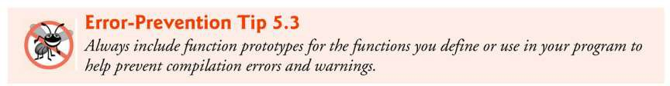
©2016 Pearson Education, Inc., Hoboken, NJ. All rights reserved.
67

Slide 68
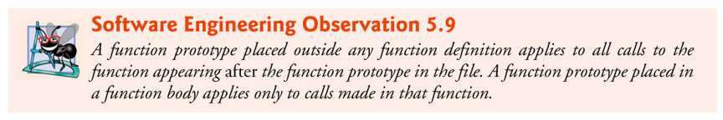
©2016 Pearson Education, Inc., Hoboken, NJ. All rights reserved.
67

Slide 69
5.7 Function Call Stack and Stack Frames
To understand how C performs function calls, we first need to consider a data structure (i.e., collection of related data items) known as a stack.
Think of a stack as analogous to a pile of dishes.
When a dish is placed on the pile, it’s normally placed at the top (referred to as pushing the dish onto the stack).
Similarly, when a dish is removed from the pile, it’s normally removed from the top (referred to as popping the dish off the stack).
Stacks are known as last-in, first-out (LIFO) data structures—the last item pushed (inserted) on the stack is the first item popped (removed) from the stack.
69

Slide 70
5.7 Function Call Stack and Stack Frames (Cont.)
An important mechanism for computer science students to understand is the function call stack (sometimes referred to as the program execution stack).
This data structure—working “behind the scenes”—supports the function call/return mechanism.
It also supports the creation, maintenance and destruction of each called function’s local variables.
69

Slide 71
5.7 Function Call Stack and Stack Frames (Cont.)
As each function is called, it may call other functions, which may call other functions—all before any function returns.
Each function eventually must return control to the function that called it.
So, we must keep track of the return addresses that each function needs to return control to the function that called it.
The function call stack is the perfect data structure for handling this information.
69

Slide 72
5.7 Function Call Stack and Stack Frames (Cont.)
Each time a function calls another function, an entry is pushed onto the stack.
This entry, called a stack frame, contains the return address that the called function needs in order to return to the calling function.
If the called function returns, instead of calling another function before returning, the stack frame for the function call is popped, and control transfers to the return address in the popped stack frame.
69

Slide 73
5.7 Function Call Stack and Stack Frames (Cont.)
Each called function always finds the information it needs to return to its caller at the top of the call stack.
And, if a function makes a call to another function, a stack frame for the new function call is simply pushed onto the call stack.
Thus, the return address required by the newly called function to return to its caller is now located at the top of the stack.
69

Slide 74
5.7 Function Call Stack and Stack Frames (Cont.)
The stack frames have another important responsibility.
Most functions have automatic variables— parameters and some or all of their local variables.
Automatic variables need to exist while a function is executing.
They need to remain active if the function makes calls to other functions.
But when a called function returns to its caller, the called function’s automatic variables need to “go away.”
69

Slide 75
5.7 Function Call Stack and Stack Frames (Cont.)
The called function’s stack frame is a perfect place to reserve the memory for automatic variables.
That stack frame exists only as long as the called function is active.
When that function returns—and no longer needs its local automatic variables—its stack frame is popped from the stack, and those local automatic variables are no longer known to the program.
69

Slide 76
5.7 Function Call Stack and Stack Frames (Cont.)
Of course, the amount of memory in a computer is finite, so only a certain amount of memory can be used to store stack frames on the function call stack.
If more function calls occur than can have their stack frames stored on the function call stack, a fatal error known as a stack overflow occurs.
69

Slide 77
5.7 Function Call Stack and Stack Frames (Cont.)
Function Call Stack in Action
Now let’s consider how the call stack supports the operation of a square function called by main
First the operating system calls main—this pushes a stack frame onto the stack.
The stack frame tells main how to return to the operating system (i.e., transfer to return address R1) and contains the space for main’s automatic variable (i.e., a, which is initialized to
10).
69

Slide 78
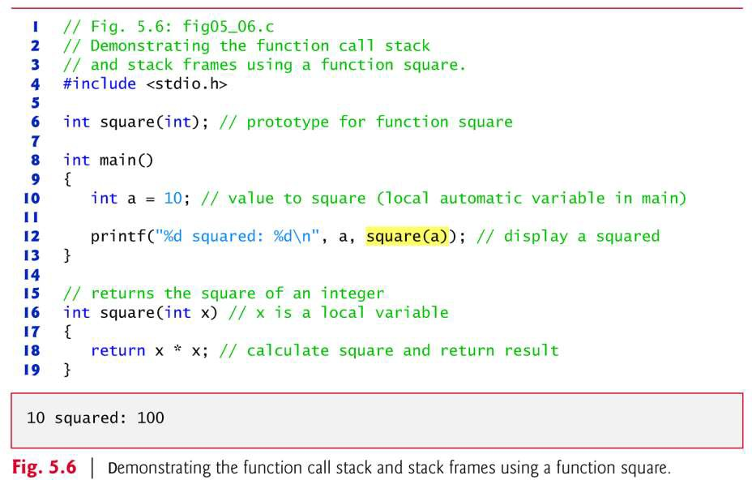
©2016 Pearson Education, Inc., Hoboken, NJ. All rights reserved.
78

Slide 79
5.7 Function Call Stack and Stack Frames (Cont.)
Function main—before returning to the operating system—now calls function square
This causes a stack frame for square to be pushed onto the function call stack (Fig. 5.8).
This stack frame contains the return address that square needs to return to main (i.e., R2) and the memory for square’s automatic variable (i.e., x).
©2016 Pearson Education, Inc., Hoboken, NJ. All rights reserved.
79

Slide 80
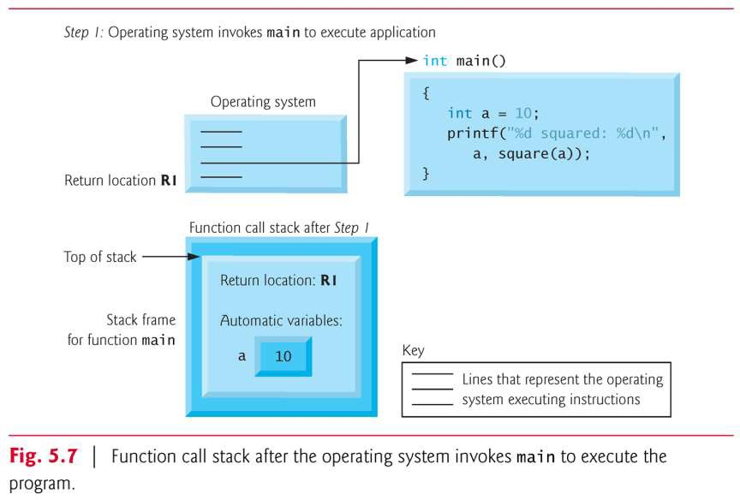
©2016 Pearson Education, Inc., Hoboken, NJ. All rights reserved.
80

Slide 81
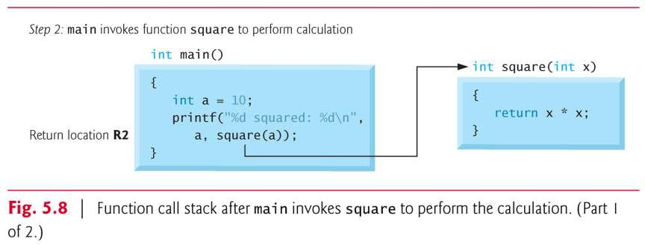
©2016 Pearson Education, Inc., Hoboken, NJ. All rights reserved.
80

Slide 82
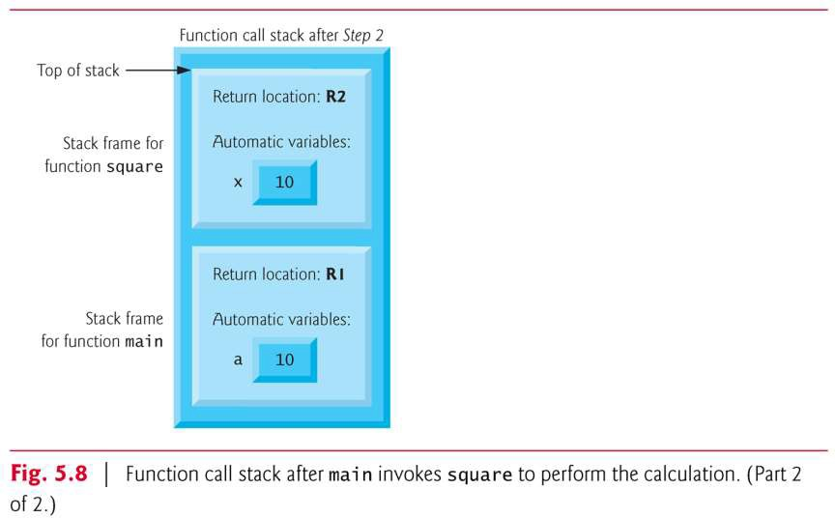
©2016 Pearson Education, Inc., Hoboken, NJ. All rights reserved.
80

Slide 83
5.7 Function Call Stack and Stack Frames (Cont.)
After square calculates the square of its argument, it needs to return to main—and no longer needs the memory for its automatic variable x.
So the stack is popped—giving square the return location in main (i.e., R2) and losing square’s automatic variable.
Figure 5.9 shows the function call stack
after square’s stack frame has been popped.
©2016 Pearson Education, Inc., Hoboken, NJ. All rights reserved.
83

Slide 84
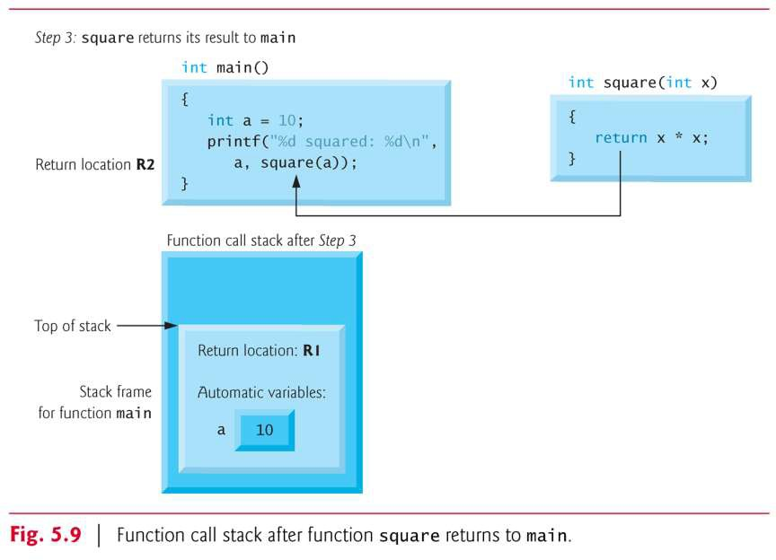
©2016 Pearson Education, Inc., Hoboken, NJ. All rights reserved.
84

Slide 85
5.7 Function Call Stack and Stack Frames (Cont.)
Function main now displays the result of calling square
Reaching the closing right brace of main causes its stack frame to be popped from the stack, gives main the address it needs to return to the operating system (i.e., R1 in Fig. 5.7) and causes the memory for main’s automatic variable (i.e., a) to become unavailable.
85

Slide 86
5.8 Headers
Each standard library has a corresponding header containing the function prototypes for all the functions in that library and definitions of various data types and constants needed by those functions.
Figure 5.6 lists alphabetically some of the standard library headers that may be included in programs.
The term “macros” that’s used several times in Fig. 5.6 is discussed in detail in Chapter 13.
You can create custom headers.
Programmer-defined headers should also use the .h
filename extension.
85

Slide 87
5.8 Headers (Cont.)
A programmer-defined header can be included by using the #include preprocessor directive.
For example, if the prototype for our square function was located in the header square.h, we’d include that header in our program by using the following directive at the top of the program:
#include "square.h"
85

Slide 88
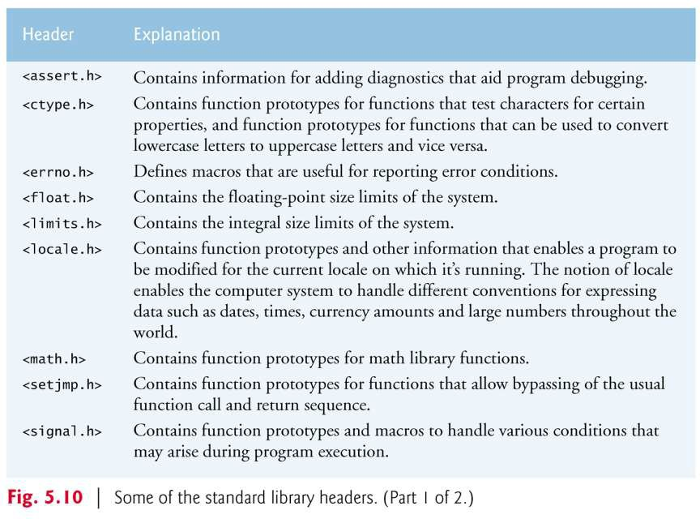
©2016 Pearson Education, Inc., Hoboken, NJ. All rights reserved.
88

Slide 89
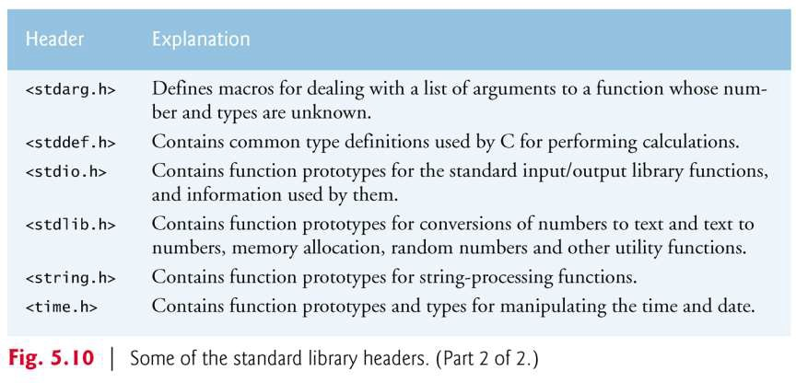
©2016 Pearson Education, Inc., Hoboken, NJ. All rights reserved.
88

Slide 90
5.9 Passing Arguments By Value and By Reference
In many programming languages, there are two ways to pass arguments—pass-by-value and pass-by-reference.
When arguments are passed by value, a copy of the argument’s value is made and passed to the called function.
Changes to the copy do not affect an original variable’s value in the caller.
When an argument is passed by reference, the caller allows the called function to modify the original
variable’s value.
Pass-by-value should be used whenever the called
function does not need to modify the value of the caller’s original variable.
90

Slide 91
5.9 Passing Arguments By Value and By Reference (Cont.)
This prevents the accidental side effects (variable modifications) that so greatly hinder the development of correct and reliable software systems.
Pass-by-reference should be used only with trusted called functions that need to modify the original variable.
In C, all arguments are passed by value.
In Chapter 6, we’ll see that array arguments are automatically passed by reference for performance reasons.
90

Slide 92
5.10 Random Number Generation
We now take a brief and, hopefully,
entertaining diversion into simulation and
game playing.
The element of chance can be introduced into computer applications by using the C standard
library function rand from the <stdlib.h>
header.
Consider the following statement:
i = rand();
The rand function generates an integer
between 0 and RAND_MAX (a symbolic constant
defined in the <stdlib.h> header).
90

Slide 93
5.10 Random Number Generation (Cont.)
Standard C states that the value of RAND_MAX must be at least 32767, which is the maximum value for a two-byte (i.e., 16-bit) integer.
The programs in this section were tested on Microsoft Visual C++ with a maximum RAND_MAX value of 32767 and on GNU gcc and Xcode LLVM with a RAND_MAX value of 2147483647.
If rand truly produces integers at random, every number between 0 and RAND_MAX has an equal chance (or probability) of being chosen each time rand is called.
The range of values produced directly by rand is often different from what’s needed in a specific application.
90

Slide 94
5.10 Random Number Generation (Cont.)
For example, a program that simulates coin tossing might
require only 0 for “heads” and 1 for “tails.”
A dice-rolling program that simulates a six-sided die would require random integers from 1 to 6.
Rolling a Six-Sided Die
To demonstrate rand, let’s develop a program to simulate 20 rolls of a six-sided die and print the value of each roll.
The function prototype for function rand is in <stdlib.h>.
We use the remainder operator (%) in conjunction with rand
as follows
rand() % 6
to produce integers in the range 0 to 5.
90

Slide 95
5.10 Random Number Generation (Cont.)
This is called scaling.
The number 6 is called the scaling factor.
We then shift the range of numbers produced by adding 1 to our previous result.
The output of Fig. 5.7 confirms that the results are in the range 1 to 6—the actual random values chosen might vary by compiler.
90

Slide 96
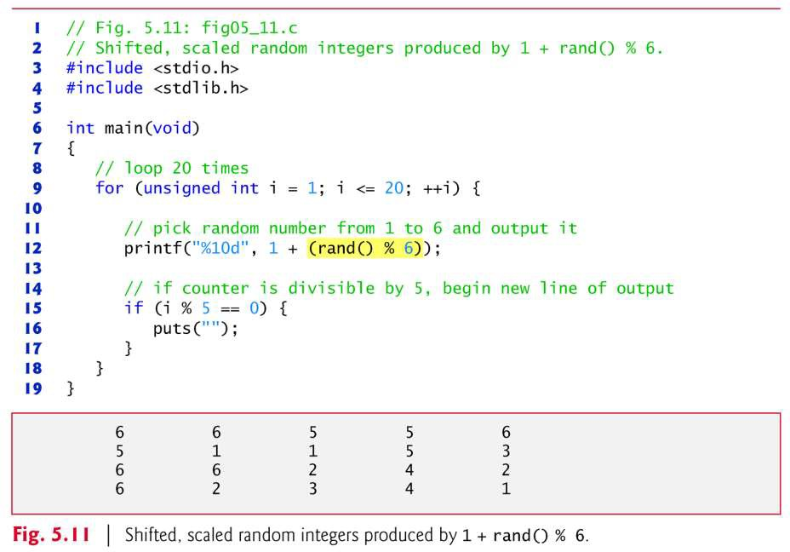
©2016 Pearson Education, Inc., Hoboken, NJ. All rights reserved.
96

Slide 97
5.10 Random Number Generation (Cont.)
Rolling a Six-Sided Die 6,000,000 Times
To show that these numbers occur approximately with equal likelihood, let’s simulate 6,000,000 rolls of a die with the program of Fig. 5.12.
Each integer from 1 to 6 should appear approximately 1,000,000 times.
As the program output shows, by scaling and shifting we’ve used the rand function to realistically simulate the rolling of a six-sided die.
97

Slide 98
5.10 Random Number Generation (Cont.)
Note the use of the %s conversion specifier to print the character strings "Face" and "Frequency" as column headers.
After we study arrays in Chapter 6, we’ll show how to replace this switch statement elegantly with a single-line statement.
97

Slide 99
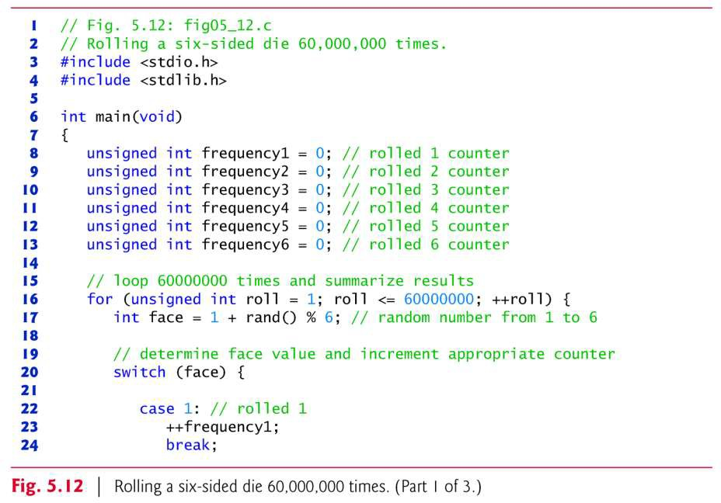
©2016 Pearson Education, Inc., Hoboken, NJ. All rights reserved.

Slide 100
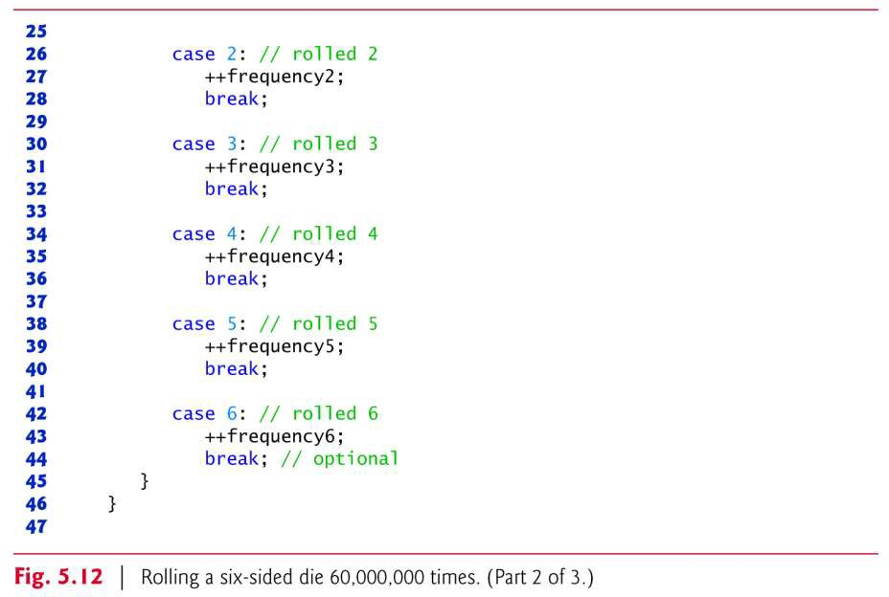
©2016 Pearson Education, Inc., Hoboken, NJ. All rights reserved.

Slide 101
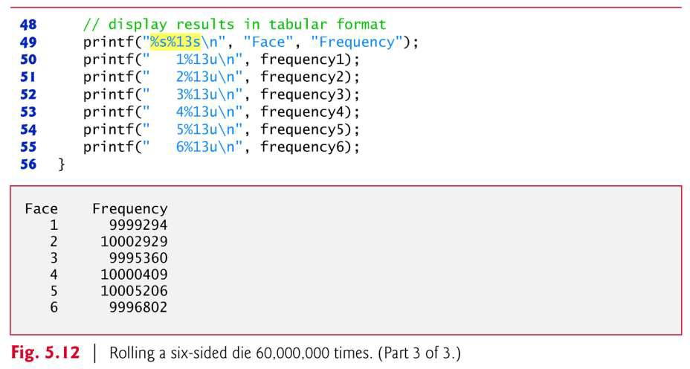
©2016 Pearson Education, Inc., Hoboken, NJ. All rights reserved.

Slide 102
5.10 Random Number Generation (Cont.)
Randomizing the Random Number Generator
Executing the program of Fig. 5.11 again produces exactly the same sequence of values.
How can these be random numbers? Ironically, this repeatability is an important characteristic of function rand.

Slide 103
5.10 Random Number Generation (Cont.)
When debugging a program, this repeatability is essential for proving that corrections to a program work properly.
Function rand actually generates pseudorandom numbers.
Calling rand repeatedly produces a sequence of numbers that appears to be random.
However, the sequence repeats itself each time the program is executed.
Once a program has been thoroughly debugged, it can be conditioned to produce a different sequence of random numbers for each execution.

Slide 104
5.10 Random Number Generation (Cont.)
This is called randomizing and is accomplished with the standard library function srand.
Function srand takes an unsigned integer argument and seeds function rand to produce a different sequence of random numbers for each execution of the program.
We demonstrate function srand in Fig. 5.13.

Slide 105
5.10 Random Number Generation (Cont.)
Function srand takes an unsigned int value as an argument.
The conversion specifier %u is used to read an unsigned int value with scanf.
The function prototype for srand is found in
<stdlib.h>.

Slide 106
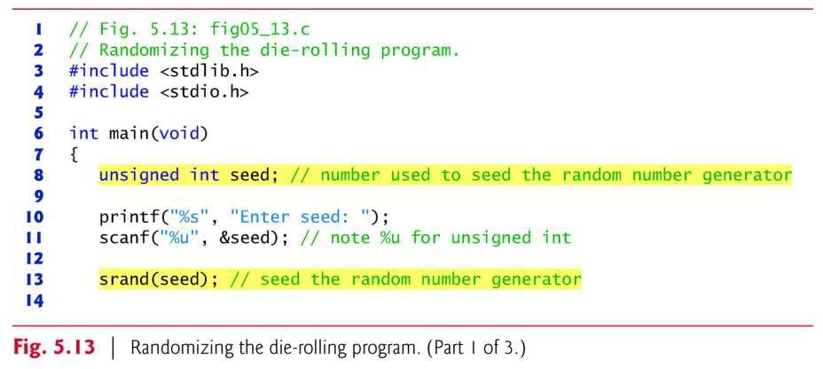
©2016 Pearson Education, Inc., Hoboken, NJ. All rights reserved.

Slide 107
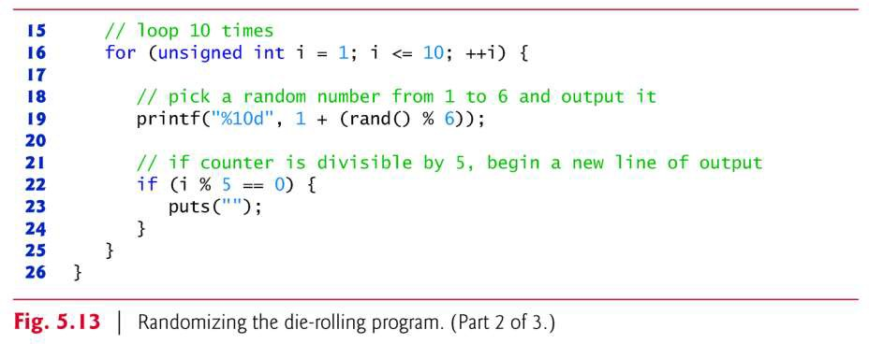
©2016 Pearson Education, Inc., Hoboken, NJ. All rights reserved.

Slide 108
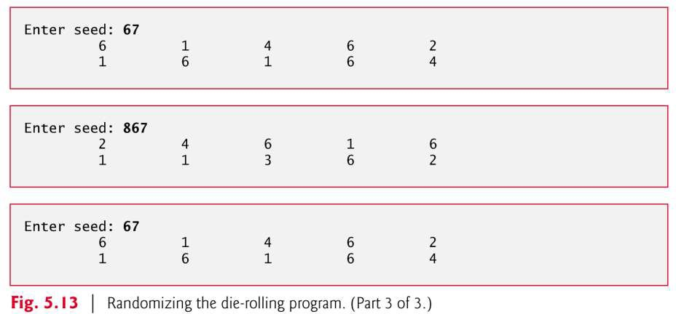
©2016 Pearson Education, Inc., Hoboken, NJ. All rights reserved.

Slide 109
5.10 Random Number Generation (Cont.)
Let’s run the program several times and observe the results.
Notice that a different sequence of random numbers is obtained each time the program is run, provided that a different seed is supplied.
To randomize without entering a seed each time, use a statement like
srand(time(NULL));
This causes the computer to read its clock to obtain the value for the seed automatically.
Function time returns the number of seconds that have passed since midnight on January 1, 1970.
109

Slide 110
5.10 Random Number Generation (Cont.)
This value is converted to an unsigned integer and used as the seed to the random number generator.
The function prototype for time is in
<time.h>.
119

Slide 111
5.10 Random Number Generation (Cont.)
Generalized Scaling and Shifting of Random Numbers
The values produced directly by rand are always in the range:
0 ≤ rand() ≤ RAND_MAX
As you know, the following statement simulates rolling a six-sided die:
face = 1 + rand() % 6;
This statement always assigns an integer value (at random) to the variable face in the range 1 ≤ face ≤ 6.
The width of this range (i.e., the number of consecutive integers in the range) is 6 and the starting number in the range is 1.

Slide 112
5.10 Random Number Generation (Cont.)
Referring to the preceding statement, we see that the width of the range is determined by
the number used to scale rand with the
remainder operator (i.e., 6), and the starting number of the range is equal to the number
(i.e., 1) that’s added to rand % 6.
We can generalize this result as follows
n = a + rand() % b;
where a is the shifting value (which is equal to
the first number in the desired range of
consecutive integers) and b is the scaling factor
(which is equal to the width of the desired range of consecutive integers).

Slide 113
5.11 Example: A Game of Chance; Introducing enum
One of the most popular games of chance is a dice game known as “craps.” The rules of the game are simple.
– A player rolls two dice. Each die has six faces. These faces contain 1, 2, 3, 4, 5, and 6 spots. After the dice have come to rest, the sum of the spots on the two upward faces is calculated. If the sum is 7 or 11 on the first throw, the player wins. If the sum is 2, 3, or 12 on the first throw (called “craps”), the player loses (i.e., the “house” wins). If the sum is 4, 5, 6, 8, 9, or 10 on the first throw, then that sum becomes the player’s “point.” To win, you must continue rolling the dice until you “make your point.” The player loses by rolling a 7 before making the point.
Figure 5.14 simulates the game of craps and Fig. 5.15 shows several sample executions.

Slide 114
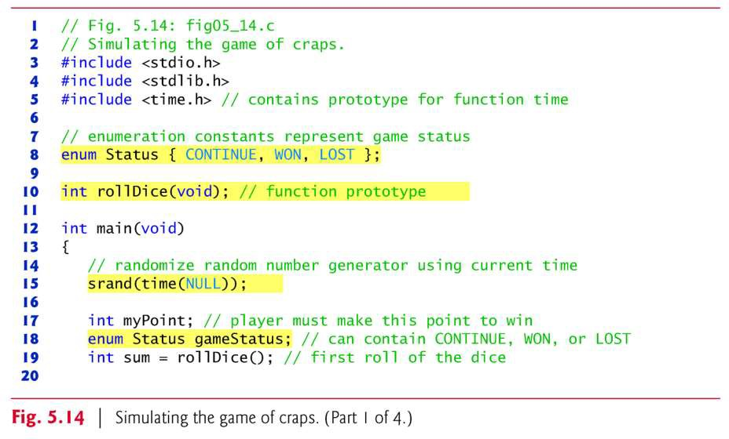
©2016 Pearson Education, Inc., Hoboken, NJ. All rights reserved.

Slide 115
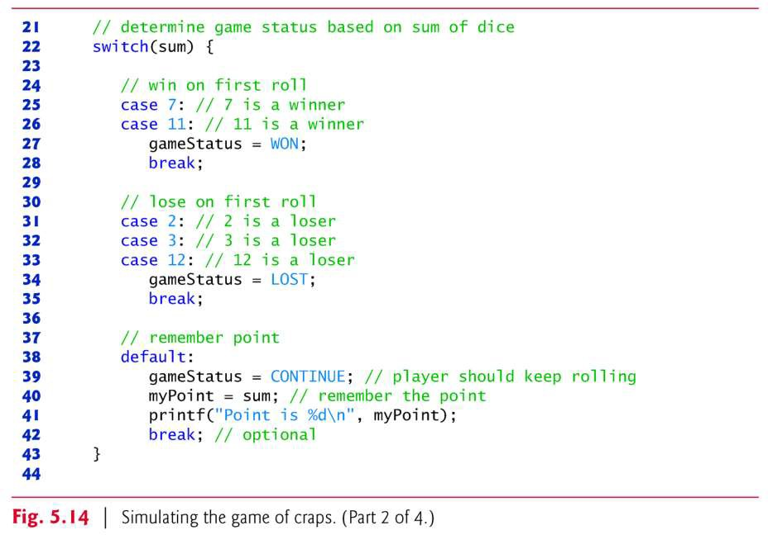
©2016 Pearson Education, Inc., Hoboken, NJ. All rights reserved.

Slide 116

©2016 Pearson Education, Inc., Hoboken, NJ. All rights reserved.

Slide 117

©2016 Pearson Education, Inc., Hoboken, NJ. All rights reserved.

Slide 118

©2016 Pearson Education, Inc., Hoboken, NJ. All rights reserved.

Slide 119

©2016 Pearson Education, Inc., Hoboken, NJ. All rights reserved.

Slide 120
5.11 Example: A Game of Chance; Introducing enum (cont.)
In the rules of the game, notice that the player must roll two dice on the first roll, and must do so later on all subsequent rolls.
We define a function rollDice to roll the dice and compute and print their sum.
Function rollDice is defined once, but it’s called from two places in the program.
Interestingly, rollDice takes no arguments, so we’ve indicated void in the parameter list
Function rollDice does return the sum of the two dice, so a return type of int is indicated in its function header and in its function prototype.

Slide 121
5.11 Example: A Game of Chance; Introducing enum (cont.)
The player may win or lose on the first roll, or may win or lose on any subsequent roll.
Variable gameStatus, defined to be of a new type—
enum Status—stores the current status.
An enumeration, introduced by the keyword enum, is a set of integer constants represented by identifiers.
Enumeration constants help make programs easier to read
Values in an enum start with 0 and are incremented by 1.

Slide 122
5.11 Example: A Game of Chance; Introducing enum (cont.)
Enumerations
The constant CONTINUE has the value 0, WON
has the value 1 and LOST has the value 2.
It’s also possible to assign an integer value to each identifier in an enum (see
Chapter 10).
The identifiers in an enumeration must be unique, but the values may be duplicated.

Slide 123

©2016 Pearson Education, Inc., Hoboken, NJ. All rights reserved.

Slide 124

©2016 Pearson Education, Inc., Hoboken, NJ. All rights reserved.

Slide 125
5.11 Example: A Game of Chance; Introducing enum (cont.)
When the game is won, either on the first roll or on a subsequent roll, gameStatus is set to WON.
When the game is lost, either on the first roll or on a subsequent roll, gameStatus is set to LOST.
Otherwise gameStatus is set to CONTINUE and the game continues.

Slide 126
5.11 Example: A Game of Chance; Introducing enum (cont.)
Game Ends on First Roll
After the first roll, if the game is over, the while statement is skipped because gameStatus is not CONTINUE.
The program proceeds to the if…else statement, which prints "Player wins" if gameStatus is WON and "Player loses" otherwise.

Slide 127
5.11 Example: A Game of Chance; Introducing enum (cont.)
Game Ends on a Subsequent Roll
After the first roll, if the game is not over, then
sum is saved in myPoint.
Execution proceeds with the while statement because gameStatus is CONTINUE.
Each time through the while, rollDice is called to produce a new sum.
If sum matches myPoint, gameStatus is set to WON to indicate that the player won, the while- test fails, the if…else statement prints "Player wins" and execution terminates.

Slide 128
5.11 Example: A Game of Chance; Introducing enum (cont.)
If sum is equal to 7, gameStatus is set to LOST to indicate that the player lost, the while-test fails, the if…else statement prints "Player loses" and execution terminates.

Slide 129
5.11 Example: A Game of Chance; Introducing enum (cont.)
Control Architecture
Note the program’s interesting control architecture.
We’ve used two functions—main and rollDice—and the switch, while, nested if…else and nested if statements.
In the exercises, we’ll investigate various interesting characteristics of the game of craps.

Slide 130
5.12 Storage Classes
In Chapters 2–4, we used identifiers for variable names.
The attributes of variables include name, type, size and value.
In this chapter, we also use identifiers as names for user- defined functions.
Actually, each identifier in a program has other attributes, including storage class, storage duration, scope and linkage.
C provides the storage class specifiers: auto, register,
extern and static.
An identifier’s storage class determines its storage duration, scope and linkage.
An identifier’s storage duration is the period during which
the identifier exists in memory.
130

Slide 131
5.12 Storage Classes (Cont.)
Some exist briefly, some are repeatedly created and destroyed, and others exist for the program’s entire execution.
An identifier’s scope is where the identifier can be referenced in a program.
Some can be referenced throughout a program, others from only portions of a program.
An identifier’s linkage determines for a multiple-source- file program whether the identifier is known only in the current source file or in any source file with proper declarations.
This section discusses storage classes and storage duration.

Slide 132
5.12 Storage Classes (Cont.)
Section 5.13 discusses scope.
Chapter 14 discusses identifier linkage and programming with multiple source files.
The storage-class specifiers can be split into automatic storage duration and static storage duration.
Keyword auto is used to declare variables of automatic storage duration.
Variables with automatic storage duration are created when the block in which they’re defined is entered; they exist while the block is active, and they’re destroyed when the block is exited.

Slide 133
5.12 Storage Classes (Cont.)
Local Variables
Only variables can have automatic storage duration.
A function’s local variables (those declared in the parameter list or function body) normally have automatic storage duration.
Keyword auto explicitly declares variables of automatic storage duration.

Slide 134
5.12 Storage Classes (Cont.)
Local variables have automatic storage duration by default, so keyword auto is rarely used.
For the remainder of the text, we’ll refer to variables with automatic storage duration simply as automatic variables.

Slide 135

©2016 Pearson Education, Inc., Hoboken, NJ. All rights reserved.
135

Slide 136
5.12 Storage Classes (Cont.)
Static Storage Class
Keywords extern and static are used in the declarations of identifiers for variables and functions of static storage duration.
Identifiers of static storage duration exist from the time at which the program begins execution until the program terminates.
For static variables, storage is allocated and initialized only once, before the program begins execution.
For functions, the name of the function exists when the program begins execution.

Slide 137
5.12 Storage Classes (Cont.)
However, even though the variables and the function names exist from the start of program execution, this does not mean that these identifiers can be accessed throughout the program.
Storage duration and scope (where a name can be used) are separate issues, as we’ll see in Section 5.13.
There are several types of identifiers with static storage duration: external identifiers (such as global variables and function names) and local variables declared with the storage-class specifier static.
Global variables and function names are of storage class
extern by default.

Slide 138
5.12 Storage Classes (Cont.)
Global variables are created by placing variable
declarations outside any function definition,
and they retain their values throughout the execution of the program.
Global variables and functions can be
referenced by any function that follows their declarations or definitions in the file.
This is one reason for using function
prototypes—when we include stdio.h in a
program that calls printf, the function
prototype is placed at the start of our file to
make the name printf known to the rest of the file.

Slide 139

©2016 Pearson Education, Inc., Hoboken, NJ. All rights reserved.
139

Slide 140

©2016 Pearson Education, Inc., Hoboken, NJ. All rights reserved.
149

Slide 141
5.12 Storage Classes (Cont.)
Local variables declared with the keyword static are still known only in the function in which they’re defined, but unlike automatic variables, static local variables retain their value when the function is exited.
The next time the function is called, the static local variable contains the value it had when the function last exited.
The following statement declares local variable
count to be static and initializes it to 1.
static int count = 1;

Slide 142
5.12 Storage Classes (Cont.)
All numeric variables of static storage duration are initialized to zero by default if you do not explicitly initialize them.
Keywords extern and static have special meaning when explicitly applied to external identifiers.
In Chapter 14 we discuss the explicit use of extern and static with external identifiers and multiple-source-file programs.

Slide 143
5.13 Scope Rules
The scope of an identifier is the portion of the program in which the identifier can be referenced.
For example, when we define a local variable in a block, it can be referenced only following its definition in that block or in blocks nested within that block.
The four identifier scopes are function scope, file scope, block scope, and function-prototype scope.
Labels (identifiers followed by a colon such as start:) are the only identifiers with function scope.
Labels can be used anywhere in the function in which they appear, but cannot be referenced outside the function body.

Slide 144
5.13 Scope Rules (Cont.)
Labels are used in switch statements (as case labels) and in goto statements (see Chapter 14).
Labels are hidden in the function in which they’re defined.
This hiding—more formally called information hiding— is a means of implementing the principle of least privilege—a fundamental principle of good software engineering.
An identifier declared outside any function has file scope.
Such an identifier is “known” (i.e., accessible) in all functions from the point at which the identifier is declared until the end of the file.

Slide 145
5.13 Scope Rules (Cont.)
Global variables, function definitions, and function prototypes placed outside a function all have file scope.
Identifiers defined inside a block have block scope.
Block scope ends at the terminating right brace (}) of the block.
Local variables defined at the beginning of a function have block scope as do function parameters, which are considered local variables by the function.
Any block may contain variable definitions.

Slide 146
5.13 Scope Rules (Cont.)
When blocks are nested, and an identifier in an
outer block has the same name as an identifier
in an inner block, the identifier in the outer
block is “hidden” until the inner block terminates.
This means that while executing in the inner
block, the inner block sees the value of its own
local identifier and not the value of the
identically named identifier in the enclosing block.
Local variables declared static still have
block scope, even though they exist from before program startup.

Slide 147
5.13 Scope Rules (Cont.)
Thus, storage duration does not affect the scope of an identifier.
The only identifiers with function-prototype scope are those used in the parameter list of a function prototype.
As mentioned previously, function prototypes do not require names in the parameter list—only types are required.
If a name is used in the parameter list of a function prototype, the compiler ignores the name.
Identifiers used in a function prototype can be reused elsewhere in the program without ambiguity.

Slide 148

©2016 Pearson Education, Inc., Hoboken, NJ. All rights reserved.

Slide 149

©2016 Pearson Education, Inc., Hoboken, NJ. All rights reserved.

Slide 150
5.13 Scope Rules (Cont.)
Figure 5.16 demonstrates scoping issues with global variables, automatic local variables, and static local variables.
A global variable x is defined and initialized to 1.
This global variable is hidden in any block (or function) in which a variable named x is defined.
In main, a local variable x is defined and initialized to 5
This variable is then printed to show that the global x is hidden in main.
Next, a new block is defined in main with another local variable x initialized to 7

Slide 151
5.13 Scope Rules (Cont.)
This variable is printed to show that it hides x in the outer block of main.
The variable x with value 7 is automatically destroyed when the block is exited, and the local variable x in the outer block of main is printed again to show that it’s no longer hidden.
The program defines three functions that each take no arguments and return nothing.
Function useLocal defines an automatic variable x and initializes it to 25
When useLocal is called, the variable is printed, incremented, and printed again before exiting the function.

Slide 152
5.13 Scope Rules (Cont.)
Each time this function is called, automatic variable x is reinitialized to 25.
Function useStaticLocal defines a static variable x
and initializes it to 50
Local variables declared as static retain their values even when they’re out of scope.
When useStaticLocal is called, x is printed, incremented, and printed again before exiting the function.
In the next call to this function, static local variable x
will contain the value 51.
Function useGlobal does not define any variables.

Slide 153
5.13 Scope Rules (Cont.)
Therefore, when it refers to variable x, the global x is used.
When useGlobal is called, the global variable is printed, multiplied by 10, and printed again before exiting the function.
The next time function useGlobal is called, the global variable still has its modified value, 10.
Finally, the program prints the local variable x in main again to show that none of the function calls modified the value of x because the functions all referred to variables in other scopes.

Slide 154

©2016 Pearson Education, Inc., Hoboken, NJ. All rights reserved.

Slide 155

©2016 Pearson Education, Inc., Hoboken, NJ. All rights reserved.

Slide 156

©2016 Pearson Education, Inc., Hoboken, NJ. All rights reserved.

Slide 157

©2016 Pearson Education, Inc., Hoboken, NJ. All rights reserved.

Slide 158
5.14 Recursion
The programs we’ve discussed are generally structured as functions that call one another in a disciplined, hierarchical manner.
For some types of problems, it’s useful to have functions call themselves.
A recursive function is a function that calls itself either directly or indirectly through another function.
Recursion is a complex topic discussed at length in upper-level computer science courses.
In this section and the next, simple examples of recursion are presented.

Slide 159
5.14 Recursion (Cont.)
This book contains an extensive treatment of recursion, which is spread throughout Chapters 5–8, 12 and Appendix F.
Figure 5.17, in Section 5.16, summarizes the 31 recursion examples and exercises in the book.
We consider recursion conceptually first, then examine several programs containing recursive functions.
Recursive problem-solving approaches have a number of elements in common.
A recursive function is called to solve a problem.
The function actually knows how to solve only the simplest case(s), or so-called base case(s).

Slide 160
5.14 Recursion (Cont.)
If the function is called with a base case, the function simply returns a result.
If the function is called with a more complex problem, the function divides the problem into two conceptual pieces: a piece that the function knows how to do and a piece that it does not know how to do.
To make recursion feasible, the latter piece must resemble the original problem, but be a slightly simpler or smaller version.
160

Slide 161
5.14 Recursion (Cont.)
Because this new problem looks like the original problem, the function launches (calls) a fresh copy of itself to go to work on the smaller problem—this is referred to as a recursive call or the recursion step.
The recursion step also includes the keyword return, because its result will be combined with the portion of the problem the function knew how to solve to form a result that will be passed back to the original caller.
The recursion step executes while the original call to the function is paused, waiting for the result from the recursion step.

Slide 162
5.14 Recursion (Cont.)
The recursion step can result in many more such recursive calls, as the function keeps dividing each problem it’s called with into two conceptual pieces.
For the recursion to terminate, each time the function calls itself with a slightly simpler version of the original problem, this sequence of smaller problems must eventually converge on the base case.
When the function recognizes the base case, returns a result to the previous copy of the function, and a sequence of returns ensues all the way up the line until the original call of the function eventually returns the final result to main.

Slide 163
5.14 Recursion (Cont.)
Recursively Calculating Factorials
The factorial of a nonnegative integer n, written n!
(pronounced “n factorial”), is the product
n · (n –1) · (n – 2) · … · 1
with 1! equal to 1, and 0! defined to be 1.
For example, 5! is the product 5 * 4 * 3 * 2 * 1, which is equal to 120.
The factorial of an integer, number, greater than or equal to 0 can be calculated iteratively (nonrecursively) using a for statement as follows:
factorial = 1;
for (counter = number; counter >= 1; counter--)
factorial *= counter;

Slide 164
5.14 Recursion (Cont.)
A recursive definition of the factorial function is arrived at by observing the following relationship:
n! = n · (n – 1)!
For example, 5! is clearly equal to 5 * 4! as is shown by the following:
5! = 5 · 4 · 3 · 2 · 1
5! = 5 · (4 · 3 · 2 · 1)
5! = 5 · (4!)
The evaluation of 5! would proceed as shown in Fig. 5.17.

Slide 165
5.14 Recursion (Cont.)
Figure 5.17(a) shows how the succession of recursive calls proceeds until 1! is evaluated to be 1 (i.e., the base case), which terminates the recursion.
Figure 5.17(b) shows the values returned from each recursive call to its caller until the final value is calculated and returned.
Figure 5.18 uses recursion to calculate and print the factorials of the integers 0–10 (the choice of the type unsigned long long int will be explained momentarily).

Slide 166
5.14 Recursion (Cont.)
If number is indeed less than or equal to 1, factorial returns 1, no further recursion is necessary, and the program terminates.
If number is greater than 1, the statement
return number * factorial(number - 1);
expresses the problem as the product of number and a recursive call to factorial evaluating the factorial of number - 1.
The call factorial(number - 1) is a slightly simpler problem than the original calculation factorial(number).

Slide 167
5.14 Recursion (Cont.)
Function factorial has been declared to receive a parameter of type long and return a result of type long.
This is shorthand notation for long int.
The C standard specifies that a variable of type long int is stored in at least 4 bytes, and thus may hold a value as large as +2147483647.
As can be seen in Fig. 5.14, factorial values become large quickly.
We’ve chosen the data type long so the program can calculate factorials greater than 7! on computers with small (such as 2-byte) integers.

Slide 168

©2016 Pearson Education, Inc., Hoboken, NJ. All rights reserved.

Slide 169

©2016 Pearson Education, Inc., Hoboken, NJ. All rights reserved.

Slide 170

©2016 Pearson Education, Inc., Hoboken, NJ. All rights reserved.
170

Slide 171

©2016 Pearson Education, Inc., Hoboken, NJ. All rights reserved.
171

Slide 172
5.14 Recursion (Cont.)
The recursive factorial function first tests whether a terminating condition is true, i.e., whether number is less than or equal to 1.
The conversion specifier %llu is used to print unsigned long long int values.
Unfortunately, the factorial function produces large values so quickly that even unsigned long long int does not help us print very many factorial values before the maximum value of an unsigned long long int variable is exceeded.
Even when we use unsigned long long int, we still can’t calculate factorials beyond 21!

Slide 173
5.14 Recursion (Cont.)
This points to a weakness in C (and most other procedural programming languages)—namely that the language is not easily extended to handle the unique requirements of various applications.
As we’ll see later in the book, C++ is an extensible language that, through “classes,” allows us to create new data types, including ones that could hold arbitrarily large integers if we wish.

Slide 174

©2016 Pearson Education, Inc., Hoboken, NJ. All rights reserved.

Slide 175

©2016 Pearson Education, Inc., Hoboken, NJ. All rights reserved.

Slide 176
5.15 Example Using Recursion: Fibonacci Series
The Fibonacci series
0, 1, 1, 2, 3, 5, 8, 13, 21, …
begins with 0 and 1 and has the property that each subsequent Fibonacci number is the sum of the previous two Fibonacci numbers.
The series occurs in nature and, in particular, describes a form of spiral.
The ratio of successive Fibonacci numbers converges to a constant value of 1.618….

Slide 177
5.15 Example Using Recursion: Fibonacci Series (Cont.)
This number, too, repeatedly occurs in nature and has been called the golden ratio or the golden mean.
Humans tend to find the golden mean aesthetically pleasing.
Architects often design windows, rooms, and buildings whose length and width are in the ratio of the golden mean.
Postcards are often designed with a golden mean length/width ratio.

Slide 178
5.15 Example Using Recursion: Fibonacci Series (Cont.)
The Fibonacci series may be defined recursively as follows:
fibonacci(0) = 0
fibonacci(1) = 1
fibonacci(n) = fibonacci(n – 1) + fibonacci(n – 2)
Figure 5.19 calculates the n^{th} Fibonacci number recursively using function fibonacci.
Notice that Fibonacci numbers tend to become large quickly.
Therefore, we’ve chosen the data type unsigned int
for the parameter type and the data type unsigned
long long int for the return type in function
fibonacci.
In Fig. 5.19, each pair of output lines shows a separate run of the program.

Slide 179

©2016 Pearson Education, Inc., Hoboken, NJ. All rights reserved.
179

Slide 180

©2016 Pearson Education, Inc., Hoboken, NJ. All rights reserved.
189

Slide 181

©2016 Pearson Education, Inc., Hoboken, NJ. All rights reserved.
181

Slide 182
5.15 Example Using Recursion: Fibonacci Series (Cont.)
The call to fibonacci from main is not a recursive call, but all subsequent calls to fibonacci are recursive
Each time fibonacci is invoked, it immediately tests for the base case—n is equal to 0 or 1.
If this is true, n is returned.
Interestingly, if n is greater than 1, the recursion step generates two recursive calls, each a slightly simpler problem than the original call to fibonacci.
Figure 5.20 shows how function fibonacci would evaluate fibonacci(3).
©2016 Pearson Education, Inc., Hoboken, NJ. All rights reserved.
182

Slide 183

©2016 Pearson Education, Inc., Hoboken, NJ. All rights reserved.
183

Slide 184
5.15 Example Using Recursion: Fibonacci Series (Cont.)
Order of Evaluation of Operands
This figure raises some interesting issues about the order in which C compilers will evaluate the operands of operators.
This is a different issue from the order in which operators are applied to their operands, namely the order dictated by the rules of operator precedence.
Fig. 5.20 shows that while evaluating fibonacci(3), two recursive calls will be made, namely fibonacci(2) and fibonacci(1).
But in what order will these calls be made? You might simply
assume the operands will be evaluated left to right.

Slide 185
5.15 Example Using Recursion: Fibonacci Series (Cont.)
For optimization reasons, C does not specify
the order in which the operands of most operators (including +) are to be evaluated.
Therefore, you should make no assumption
about the order in which these calls will execute.
The calls could in fact execute fibonacci(2)
first and then fibonacci(1), or the calls could
execute in the reverse order, fibonacci(1)
then fibonacci(2).
In this program and in most other programs, the final result would be the same.

Slide 186
5.15 Example Using Recursion: Fibonacci Series (Cont.)
But in some programs the evaluation of an operand may have side effects that could affect the final result of the expression.
C specifies the order of evaluation of the operands of only four operators—namely &&, ||, the comma (,) operator and ?:.
The first three of these are binary operators whose operands are guaranteed to be evaluated left to right.

Slide 187
5.15 Example Using Recursion: Fibonacci Series (Cont.)
[Note: The commas used to separate the arguments in a function call are not comma
operators.] The last operator is C’s only ternary
operator.
Its leftmost operand is always evaluated first; if the leftmost operand evaluates to nonzero, the middle operand is evaluated next and the last operand is ignored; if the leftmost operand evaluates to zero, the third operand is evaluated next and the middle operand is ignored.

Slide 188

©2016 Pearson Education, Inc., Hoboken, NJ. All rights reserved.

Slide 189

©2016 Pearson Education, Inc., Hoboken, NJ. All rights reserved.

Slide 190
5.15 Example Using Recursion: Fibonacci Series (Cont.)
Exponential Complexity
A word of caution is in order about recursive programs like the one we use here to generate Fibonacci numbers.
Each level of recursion in the fibonacci function has a doubling effect on the number of calls—the number of recursive calls that will be executed to calculate the n^{th} Fibonacci number is on the order of 2^{n}.
This rapidly gets out of hand.
Calculating only the 20th Fibonacci number would require on the order of 2²⁰ or about a million calls, calculating the 30th Fibonacci number would require on the order of 2³⁰ or about a billion calls, and so on.

Slide 191
5.15 Example Using Recursion: Fibonacci Series (Cont.)
Computer scientists refer to this as exponential complexity.
Problems of this nature humble even the world’s most powerful computers!
Complexity issues in general, and exponential complexity in particular, are discussed in detail in the upper-level computer science curriculum course generally called “Algorithms.”

Slide 192
5.15 Example Using Recursion: Fibonacci Series (Cont.)
The example we showed in this section used an intuitively appealing solution to calculate Fibonacci numbers, but there are better approaches.
Exercise 5.48 asks you to investigate recursion in more depth and propose alternate approaches to implementing the recursive Fibonacci algorithm.

Slide 193
5.16 Recursion vs. Iteration
Both iteration and recursion are based on a control statement: Iteration uses a repetition statement; recursion uses a selection statement.
Both iteration and recursion involve repetition: Iteration explicitly uses a repetition statement; recursion achieves repetition through repeated function calls.
Iteration and recursion each involve a termination test: Iteration terminates when the loop-continuation condition fails; recursion when a base case is recognized.

Slide 194
5.16 Recursion vs. Iteration (Cont.)
Iteration with counter-controlled repetition and recursion each gradually approach termination: Iteration keeps modifying a counter until the counter assumes a value that makes the loop-continuation condition fail; recursion keeps producing simpler versions of the original problem until the base case is reached.
Both iteration and recursion can occur infinitely: An infinite loop occurs with iteration if the loop-continuation test never becomes false; infinite recursion occurs if the recursion step does not reduce the problem each time in a manner that converges on the base case. Infinite iteration and recursion typically occur as a result of errors in a
program’s logic.

Slide 195
5.16 Recursion vs. Iteration (Cont.)
Recursion has many negatives.
It repeatedly invokes the mechanism, and consequently the overhead, of function calls.
This can be expensive in both processor time and memory space.

Slide 196
5.16 Recursion vs. Iteration (Cont.)
Each recursive call causes another copy of the function (actually only the function’s variables) to be created; this can consume considerable memory.
Iteration normally occurs within a function, so the overhead of repeated function calls and extra memory assignment is omitted.
So why choose recursion?

Slide 197

©2016 Pearson Education, Inc., Hoboken, NJ. All rights reserved.
197

Slide 198
5.16 Recursion vs. Iteration (Cont.)
Figure 5.21 summarizes by chapter the 31 recursion examples and exercises in the text.
©2016 Pearson Education, Inc., Hoboken, NJ. All rights reserved.
198

Slide 199

©2016 Pearson Education, Inc., Hoboken, NJ. All rights reserved.
199

Slide 200
5.16 Recursion vs. Iteration (Cont.)
Good software engineering is important.
High performance is important.
Unfortunately, these goals are often at odds with one another.
Good software engineering is key to making more manageable the task of developing the larger and more complex software systems we need.
High performance is key to realizing the systems of the future that will place ever greater computing demands on hardware.
Where do functions fit in here?
©2016 Pearson Education, Inc., Hoboken, NJ. All rights reserved.
200

Slide 201

©2016 Pearson Education, Inc., Hoboken, NJ. All rights reserved.

Slide 202

©2016 Pearson Education, Inc., Hoboken, NJ. All rights reserved.

Slide 203
5.17 Secure C Programming
Secure Random Numbers
The C standard library does not provide a secure random-number generator.
According to the C standard document’s description of
function rand, “There are no guarantees as to the quality
of the random sequence produced and some
implementations are known to produce sequences with distressingly non-random low-order bits.”
The CERT guideline MSC30-C indicates that
implementation-specific random-number generation
functions must be used to ensure that the random
numbers produced are not predictable—this is
extremely important, for example, in cryptography and other security applications.

Slide 204
5.17 Secure C Programming (Cont.)
In Section 5.10, we introduced the rand function for generating pseudorandom numbers.
The guideline presents several platform-specific random-number generators that are considered to be secure.
For example, Microsoft Windows provides the CryptGenRandom function, and POSIX based systems (such as Linux) provide a random function that produces more secure results.
For more information, see guideline MSC30-C at
https://www.securecoding.cert.org.

